Slide 1
The pitfalls of using Copilot for Power BI
J.A.R.V.I.S. or Clippy ?!

Slide 3




Let’s Connnect
Michael Tenner
Linkedin
Daten-WG
Youtube

Slide 4
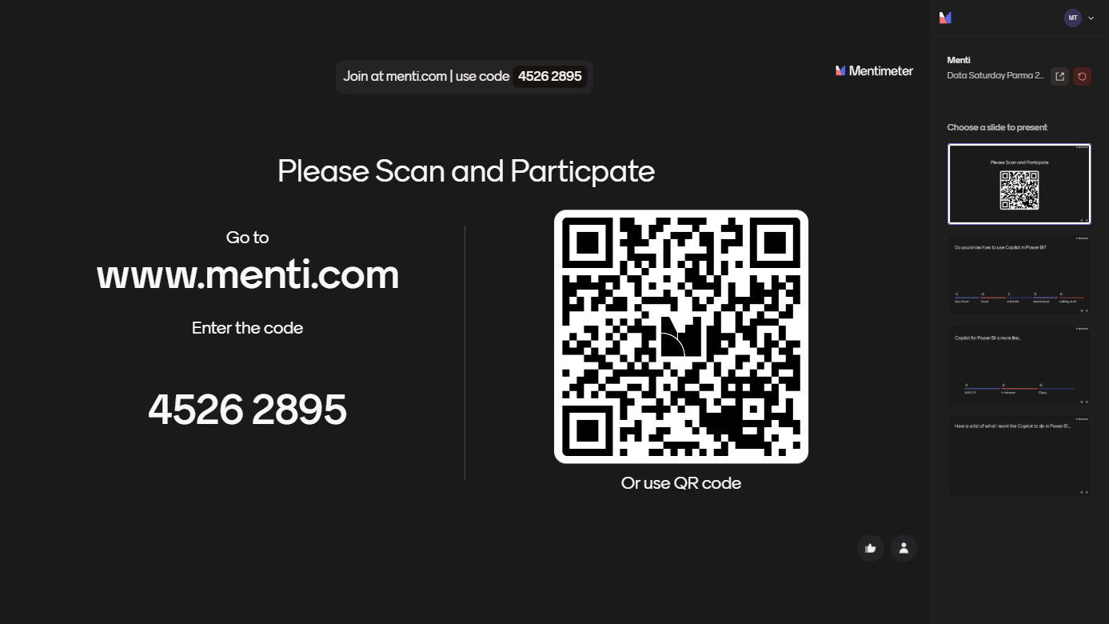
2 Sides of the Medal – Technical Capabilities and real Wolrd expectations

Slide 5


AI should not only analyze data, but also explain it in an understandable way, identify possible courses of action, and take immediate action. Our ideas are partly strongly influenced by pop culture and general AI hype.
„I invented time travelling..“

Slide 6
Copilot for different target groups
Management / C-level
Top decision-making level – strategy and control
Team leaders / Division managers
Middle management – operational management and division control
Controller / Finance department / HR department
Specialized functions – financial management and controlling
End users
Operational employees – (specialist areas such as sales, marketing, HR, IT administrators) Users from specialist departments
Data analysts / BI developers
Technical experts – dashboard creation, development, and data modeling

Slide 7
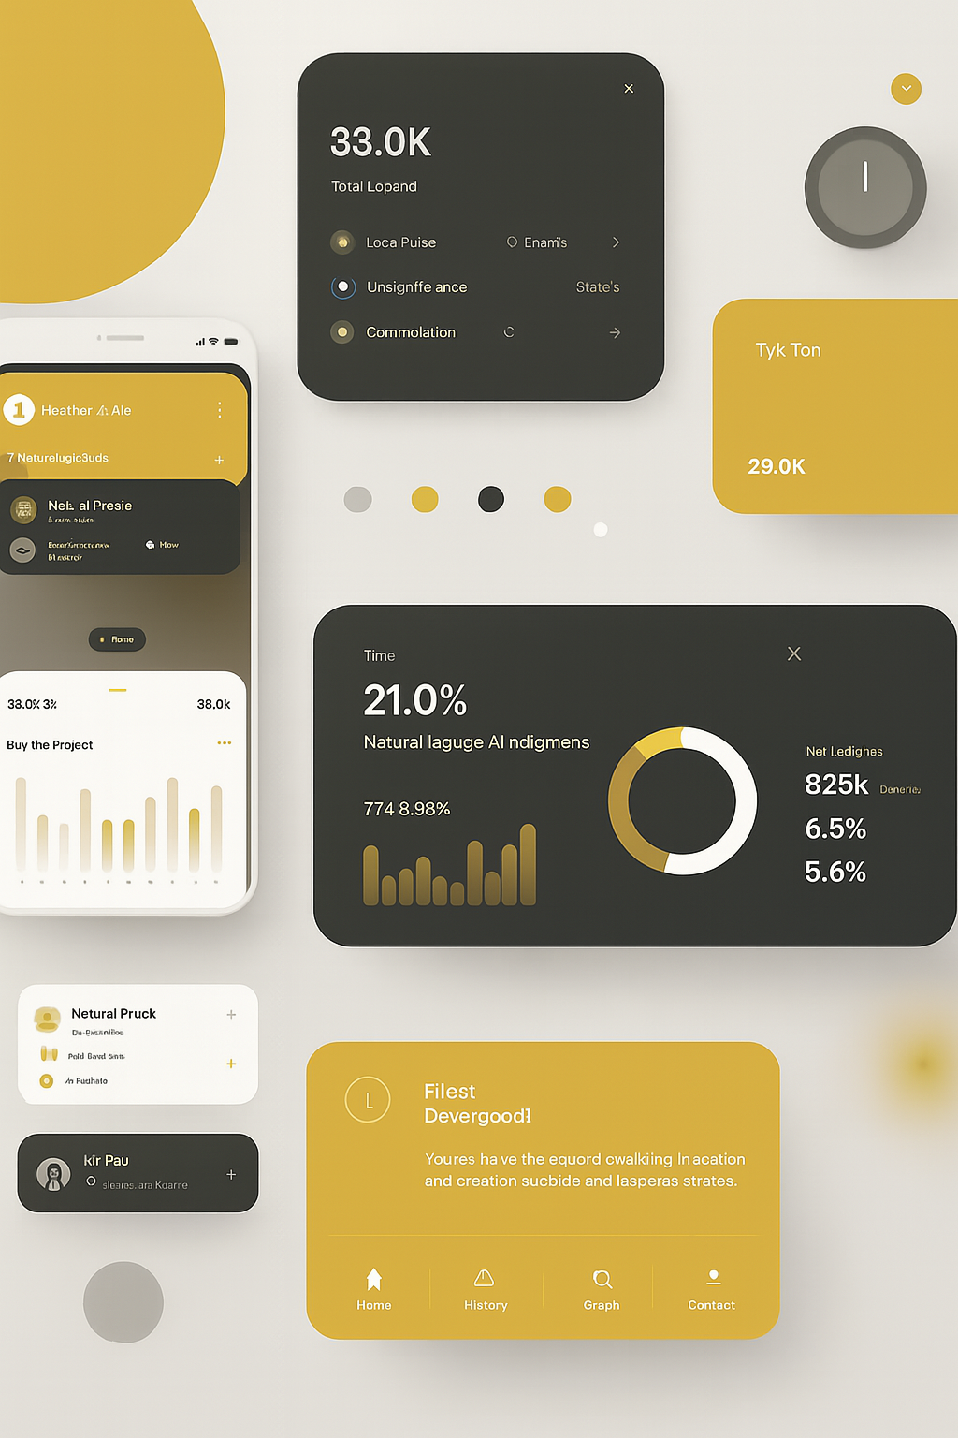

What is (or should be) Copilot in Power BI?
Ask questions – get answers
You ask questions in natural language and automatically receive insights, visualizations, or even DAX formulas.
Intelligent pattern recognition
Copilot recognizes patterns and relationships in the data and suggests the next steps.
Idea generation and exploration
Quickly create diagrams to get ideas for visual representation without advanced Power BI knowledge.
Support with data analysis and report creation
Easily perform descriptive analyses and automatically create
automatically generate reports with formulas in DAX

Slide 8
Must-haves and stakeholder expectations of Copilot Different relevance depending on the target group
Simple and intuitive operation
Reliability and precision
Seamless integration
Data protection and compliance
Transparency and traceability
Adaptability
Notes:
Must-haves and stakeholder expectations
To ensure that Copilot in Power BI is actually used on a daily basis, stakeholders primarily expect the following:
Simple and intuitive operation Copilot must be easy to understand and use without extensive training, even for non-technical users.
Reliability and precision The analyses and answers provided must be comprehensible, correct, and trustworthy.
Seamless integration Copilot should integrate seamlessly into existing Power BI reports, workflows, and systems.
Data protection and compliance Sensitive company data must be protected and all compliance requirements must be met.
Transparency and traceability Users want to understand how Copilot arrives at its recommendations and analyses.
Adaptability Different roles and teams should be able to flexibly adapt Copilot to their individual questions and requirements.
Only when these expectations are met can Copilot be successfully implemented in Power BI – and stakeholders experience real added value.

Slide 9


Assessment of current fit with requirements Varies depending on target group
Simple and intuitive operation
Generally speaking, there is no reason to put broader use on hold – individual target groups are served better than others.
Reliability and accuracy
The quality of the output varied greatly. Some results were good, but some of the simplest questions were answered incorrectly. Beginners in particular will find this overwhelming.
Seamless integration
Not yet 100% there, but at a level that would be acceptable for use by different target groups.
Data protection and compliance
Depends on the general policy regarding Copilot and AI use.
Transparency and traceability
Currently a problem area – even if filters etc. are specified, a certain level of data and AI expertise is required to ensure safe use. Same questions do not always yield the same results
Adaptability
Provided via metadata and enhancements, still with certain restrictions but to an acceptable extent. High expectations here in the future due to MCP.
Notes:
Must-haves and stakeholder expectations
To ensure that Copilot in Power BI is actually used on a daily basis, stakeholders primarily expect the following:
Simple and intuitive operation Copilot must be easy to understand and use without extensive training, even for non-technical users.
Reliability and precision The analyses and answers provided must be comprehensible, correct, and trustworthy.
Seamless integration Copilot should integrate seamlessly into existing Power BI reports, workflows, and systems.
Data protection and compliance Sensitive company data must be protected and all compliance requirements must be met.
Transparency and traceability Users want to understand how Copilot arrives at its recommendations and analyses.
Adaptability Different roles and teams should be able to flexibly adapt Copilot to their individual questions and requirements.
Only when these expectations are met can Copilot be successfully implemented in Power BI – and stakeholders experience real added value.

Slide 10
True Results of POC at a client
Power BI & Copilot Future on Hold?! Traditional reports and dashboards still outperform the results of Copilots for Power BI. Nevertheless, the potential that is shown to different user groups is immense and should be included. Given the current pace of development, any result is merely a snapshot. It would be criminal not to include this in strategic considerations on data utilization. July 2025

Slide 11
Copilot for Power BI – Strategic Opportunity at an Early Stage
Copilot promises transformative value – but is still emerging
Enables natural language interaction with data: Ask → Analyze → Act (Claim by MSFT)
Supports automation in reporting, DAX generation, and insights
Integration into Power BI Desktop and Service completed
Reality check – current capabilities remain limited
Early-stage performance; useful for simple use cases only
Results are inconsistent for complex queries or unclear metadata
Adoption requires AI/Data literacy and critical interpretation
Implication: Copilot must be treated as a strategic investment, not a plug-and-play solution

Slide 12
Caution Required – Results Depend on Models, Metadata & User Competence
Copilot output is only as good as the foundation behind it
Clean models and enriched metadata are prerequisites for value
Copilot performs well with clear questions and context-rich datasets
High risk of misinterpretation without user understanding
Behavior is non-deterministic
Small changes in input can lead to vastly different results
Inconsistent logic hampers trust and scalability
Prompt design can strongly vary the output
Implication: Robust governance, user training, and iterative validation are essential for safe deployment.

Slide 13
One Size Does Not Fit All – Tailored Rollout Required by Stakeholder Group
Needs vary significantly across roles
Executives: strategic insights, intuitive summaries, trust in outcomes
Controllers/HR: accuracy, compliance, automation of reports
Operational users: ease of use, visual outputs, quick answers
BI teams: modeling support, documentation, advanced DAX
Failure to differentiate creates friction
Generic rollouts lead to low adoption and wasted investment
Misalignment with user expectations triggers resistance
Implication: Rollout success depends on persona-based adoption strategies and clear communication.

Slide 14
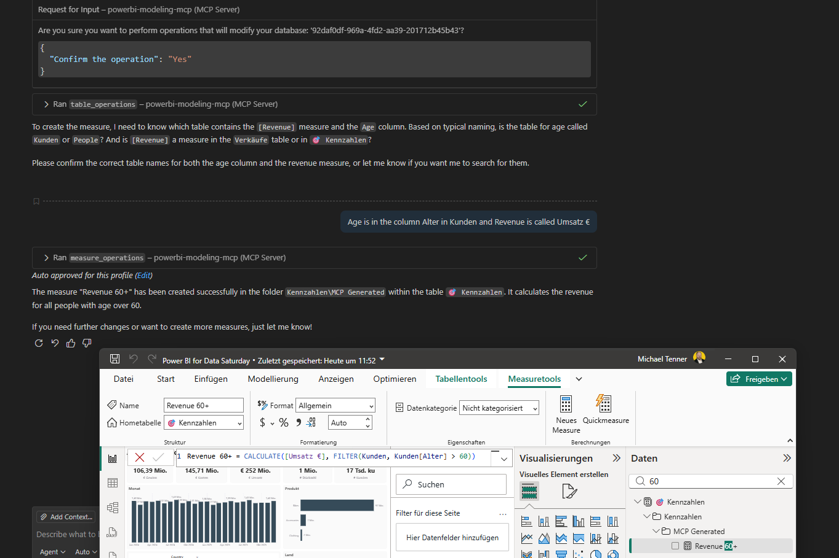
The new KID – MCP Server for POWER BI
MCP – Machine Context Protocol
Is this still Copilot?
Copilot likes Calulate+Filter?
Intro Source Injea Park:
https://www.youtube.com/watch?v=0ZRDTZm1iaI

Slide 15
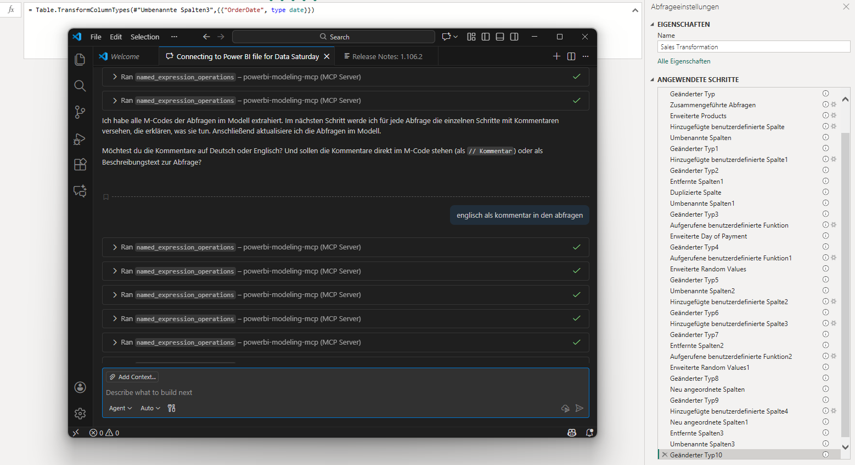
Use Case MCP – Comment my M-Code
MCP – Machine Context Protocol
Intro Source Injea Park:
https://www.youtube.com/watch?v=0ZRDTZm1iaI

Slide 16

Target specific personas and build trust in solution: How can this be achieved?
Listen and understand
Active exchange with target groups: What challenges and wishes are there regarding Power BI & Copilot?
Take concerns seriously
Openly address and transparently communicate uncertainties about data protection, reliability, or loss of control. Building data and AI expertise among all users is essential!
Ask about expectations
Conduct short surveys, workshops, or interviews to determine needs and maturity levels in dealing with AI.
Provide contact persons and support
Appoint contact persons in each area who will accompany Copilot in practice and provide support if questions arise.
Provide practical examples
Demonstrate Copilot using typical use cases for each persona – e.g., finance report for controllers, quick check for management.
Interviews
Workshops
Survey

Slide 17

2 Sides of the Medal – Technical Capabilities and real Wolrd expectations

Slide 18
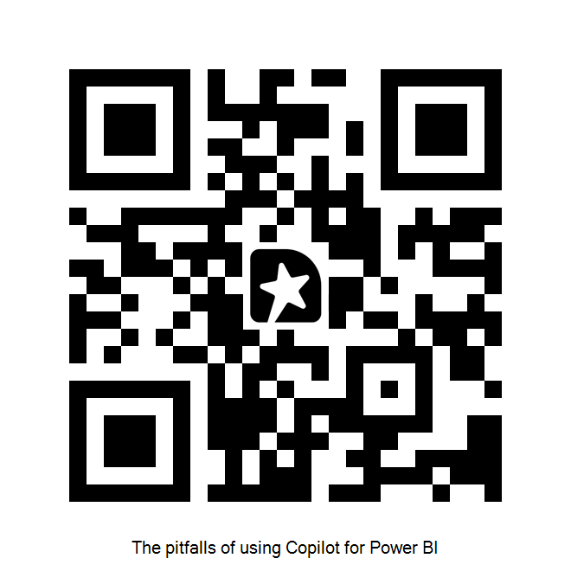
Feedback highly welcome! I vostri commenti sono molto graditi!

